Slide 1


SEICHE 2023 Intermediate Arduino Programming for IoT
Instructor: Paul Frommeyer
www.paulfrommeyer.com
Corporate Sponsor: DXC Technology

Slide 2
REMINDER YOU MUST HAVE A WORKING LED MATRIX DISPLAY TO TAKE THIS CLASS! If displays are lost or damaged, replacements are $70 with 1-week lead time for replacement

Slide 3
Lesson Plan Overview
Lesson 1: 7Feb23 – Review, Addressing, and Pointers
Overview of lesson plan
Class Exercise: Validation of sketch uploading
Class Exercise: Validation of binary create and upload
More on the Preprocessor
Memory Organization and Variables
Review of addressing and pointers
Using pointers to variables
Declaring pointers in function calls
Call-by-value Function Calls
Call-by-reference Function Calls
Lesson 2: 14Feb23 – More Gory Details
Class Exercise: Call-by-reference variables
Introduction to Complex Data Structures
Using complex data structures
Storage declarations and Arduino
Lesson 3: 21Feb23 – Fonts Redux
MD_Parola library font usage review
The MD_Parola font format
Designing your own fonts
Declaring your own fonts
Using your own fonts with MD_Parola
Lesson 4: 28Feb23 – Intro to Visual Studio Code
Introduction to VSC
https://code.visualstudio.com/docs/introvideos/overview
VSCode Installation
VSCode Integration with Arduino and ESP8266
Lesson 5: 7Mar23 – Filesystems
Introduction to mass storage filesystems
The SD FAT, FAT16, and FAT32 filesystems
The exFAT filesystem
Introduction to SPIFFS
Class Exercise: Using SPIFFS
Lesson 6: 21Mar23 – WiFi
Review of WiFi technology (but no gory details)
Class Exercise: Review of WiFi access with WiFi Manager
Web server and client HTTP architecture
Introduction to HTML
Creating a basic ESP8266 web server
Lesson 7: 28Mar23 – Web Technology
More on HTML tags
HTTP and Mime Types
Using SPIFFS
Class Exercise: Display A Web Page
Lesson 8: 4Apr23 – Internet Access
Class Exercise: Displaying Sensor Data With Async Web Server
Class Exercise: Displaying form data with MD_Parola
Obtaining information from an Internet web page
Obtaining weather information from the Internet
Class Exercise: Displaying weather information
Lesson 9: 11Apr23 – IoT Messaging and MQTT
Introduction to IoT network messaging and MQTT
Subscribing to an MQTT service
Publishing to an MQTT service
Class Exercise: Using MQTT and WiFi
Lesson 10:18Apr23 – Version control and Git
The need for document version control
The Git version control system
Installing Git
Using Git
Introduction to Github
Using Github
Class Exercise: Signing up for a Github account

Slide 4

Flash Drive Contents Reminder
When I update parts of your flash drives, you can either recopy the entire section, or just copy the updated part.
However, you will need to explicitly copy any new files so that they are locally accessible on your laptops
Copying just lesson files will– wait for it!– copy only the lesson files.
Make certain you have copied everything in RED! You should already have previously copied everything else!
FLASH DRIVE
IntermediateProgramming-Software
Archive–BasicProgrammingWith Arduino-Fall2022
Archive-IntroductionToArduino-Spring2022
IntermediateProgramming-Software
IntermediateProgramming-Lessons
IntermediateProgramming-Documentation
ESP8266FS-0.5.0.zip
IntermediateProgramming-Lessons
IntermediateProgramming-Documentation
IntermediateProgramming-Lesson1
IntermediateProgramming-Lesson2
IntermediateProgramming-Lesson3
IntermediateProgramming-Lesson7
ArduinoReference
Beginning C for Arduino, 2nd Edition
BoardsGuides
D1 Mini Reference
ElectronicsReference
IoT Reference
LED Matrix Display Architecture
HackSpace Magazine
Can’t do reading homework without the files!

Slide 5
Lesson 7 – Web Technology
Part A
More on HTML tags
The Image Tag
Class Exercise – Image Tags
Hyperlinks
Class Exercise – Hyperlinks
Web Page Inspection
HTTP and Mime Types
Part B
Using SPIFFS
Class Exercise: Display A Web Page

Slide 6
More on HTML Tags
There are seemingly innumerable HTML tags
The most critical tags do not just format text, they cause the browser, and sometimes the server to take actions
One common action is to display another file, particularly images
Another common action is to jump to another web page (a “hyperlink”)
And yet another common action is send input from the client browser back to the server (form input)
Just like subroutines and CLI programs, certain tags take arguments, which are parameters specified inside the tag which tell the client browser or the server what to do
Note also that not all tags necessarily take closing delimiters, e.g., </b>. This is particularly true of “action tags”.
We will look at all of these in turn

Slide 7
The IMG tag
The IMG tag is used to include images
The images are typically on the same server as the web page with the IMG tag, but they don’t have to be
The img tag employs several arguments, and these arguments each take data called parameters
Here is the full tag syntax:
<img src=“url|filename” [alt=“descriptive text” [width=“x”] [height=“y”]>
And here are what all those arguments and parameters do:
<img : the start of the tag itself, including the opening < delimiter
src= : specifies the image filename, or url of the image, to be included at this location on the page
alt= : Optional parameter which specifies plain text that will be displayed by a browser if it doesn’t know how to handle the image type specified. Rarely a problem these days, but proper form
width= and height= : Optional parameter which allows rescaling of an image. If not provided, image will be displayed at its native resolution.
> : The closing delimeter for the tag
Note that the parameters for arguments are always in “double quotes”!

Slide 8

The IMG tag (cont.)
Let’s see what all that looks like on the live internet. Here is a screen capture of the main page for http://congress.gov. We are interested in the graphic element (picture) outlined in red:
<img src="https://www.congress.gov/img/video-legislative-process.jpg" alt="Legislative Process video" width="204" height="148">
Here is that graphic element “scraped” from the page (via right click -> Save As) and displayed on its own

Slide 9
Class Exercise: Image Tags
Let’s add that graphic to our web page from last time. Open the file seiche.html (in your Lesson7 folder) in your HTML editor (VS Code, Kate, or Notepad) and modify it to look like this:
<html>
<head>
<title>SEICHE Website</title>
</head>
<body>
<h1>Welcome to our web page!</h1>
<img video-legislative-process.jpg>
</body>
</html>
You will need to “scrape” the graphic from the congress.gov page by opening that page in a browser, then right-clicking on the image, then selecting “Save Image As”. Navigate to the Lesson7 folder where your seiche.html file is and save the image
Once you have modified your HTML file and saved the graphic, save your HTML file, then open seiche.html in a browser.
You should see a display similar to that of Windows Firefox shown at right

Slide 10
Hyperlinks
“In computing, a hyperlink, or simply a link, is a digital reference to data that the user can follow or be guided to by clicking or tapping. A hyperlink points to a whole document or to a specific element within a document. Hypertext is text with hyperlinks. The text that is linked from is known as anchor text.” – Wikipedia
Hyperlinks are the heart and soul of the web– they are what “make it work”
A little known fact is that hyperlinks were used prior to the web. A hyperlinked data storage system famous in it’s day was Apple’s Hypercard for the Macintosh
In HTML, no surprise, hyperlinks are implemented as tags. And the hyperlink tag syntax looks like this: <a href=“url”> HTML body content– any HTML body content! </a>
Example: <a href="https://www.w3schools.com/tags/tag_a.asp">Hyperlink Tag Reference Page</a>
W3C Hyperlink reference page is here: https://www.w3schools.com/tags/tag_a.asp (did you see what I did there? ☺ )
Note that:
The hyperlinks tag has both opening <a> and closing </a> delimeters
Since any HTML can be “made into” a hyperlink by enclosing it within the opening and closing tags, entire images can be made into tags: <a href="https://congress.gov"><img src=video-legislative-process.jpg></a>

Slide 11

Class Exercise: Hyperlinks
Now let’s add some hyperlinkage to our sample HTML file. Make a copy of your seiche.html file by saving it as hyperlink.html. Then modify the new file as shown below to turn the legislative process picture into a hyperlink.
<html>
<head>
<title>SEICHE Website</title>
</head>
<body>
<h1>Welcome to our web page!</h1>
<a href="https://congress.gov">
<img src=video-legislative-process.jpg>
</a>
</body>
</html>
Once you have modified your HTML file and saved it, open the file in a browser. Your should see a page like the one at right.
Click (right-click) on the image. What happens?
Note that, as shown in the HTML here, HTML parsers (browsers) ignore whitespace, so you can arrange tags on their own lines to make the HTML easier to read.
Doesn’t look any different, does it?

Slide 12
Web Page Inspection
If you navigate to good old http://congress.gov, and once again left click on the image we’ve been using, you should see the menu at right if you are using Firefox.
This time, select “Inspect”
This will pop some developers’ HTML inspection windows, as see below.

Slide 13
Web Page Inspection (cont.)
And of course, you can do the same thing for the page(s) y’all just made!

Slide 14
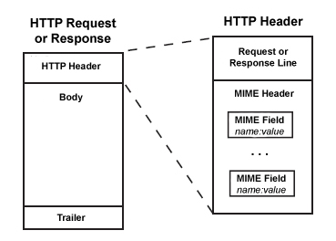
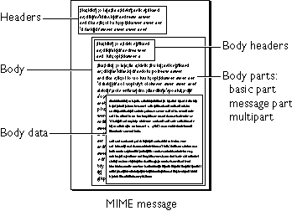
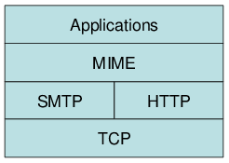
HTTP and MIME Types
Multipurpose Internet Mail Extensions (MIME) were a series of protocols developed for encapsulating binary data (applications, images) in plain text.
MIME was originally used for the plain-text based e-mail systems of the 1990’s
When the W3C (Word Wide Web Consortium, natch) needed a protocol for identifying data types in HTTP, they chose the already-existing MIME, rather than reinvent the wheel
You don’t need to know the gory details for this class, but you’ll see MIME references frequently when working with HTML and webservers!

Slide 15
Using SPIFFS
We already loaded the SPIFFS tool into our IDE’s. Now we will learn how to use it.
SPIFFS requires that any data to be uploaded be present in a folder named “data” in the same folder as the sketch that will be using it: [SKETCH7A] SKETCH7A.ino [data] file1 file2 …..
This data is uploaded by selecting the ESP8266 Sketch Data Upload item from the Tools menu in the IDE.
When the menu item is selected, all files in the “data” folder are uploaded to the ESP8266 microcontroller flash

Slide 16
Using SPIFFS (cont.)
A critical aspect of using SPIFFS is that you must be aware of just how much storage the files you are uploading use.
The ESP8266 Wemos D1 Mini we use by default has 4MB of flash. That has to be divided between code and SPIFFS storage.
You can view, and change, the allocation from the Tools menu as shown at right
The default 2:1 ratio of SPIFFS (FS) to code (OTA) is usually adequate in most cases
If you need a gob of storage for web files, you’ll need to move to an ESP32. Which will also be a much faster server.

Slide 17
CLASS EXERCISE – DISPLAY A WEB PAGE!
Open SKETCH7A; do not upload it!!
The necessary web files are already in the “data” directory, however, you will need to upload them
As shown previously, select ESP8266 Data Upload from the Tools menu to initiate the upload of the data files to your display
Once the data has uploaded, upload your sketch as usual
You will need to obtain the IP address of your WiFi connection from the Serial Monitor (I haven’t added a Parola IP display to this sketch yet.)

Slide 18
DISPLAY A WEB PAGE! (cont.)
Once you have the IP address of your display, open it in a browser using a URL, thus: http://ip-address
You should see a browser display like the one below!

Slide 19
Formal End of Lesson 5
HOMEWORK
No Homework This Week
In next week’s exciting episode
Review of WiFi technology (but no gory details)
Class Exercise: Review of WiFi access with WiFi Manager
Uploading a web page using SPIFFS
Class Exercise: Create a basic web server

Slide 20
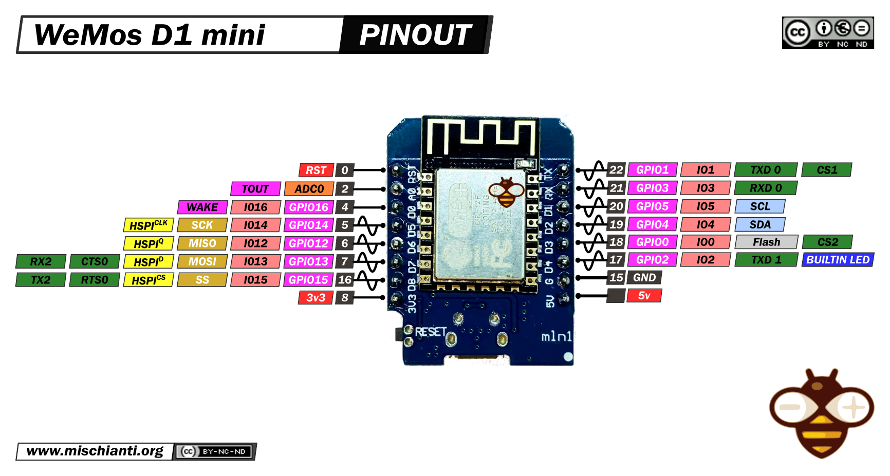
Our Microcontroller: The WeMos D1 Mini
Hilights
11 digital IO: all are interrupt and pwm capable (except D0/GPIO16)
1 analog input (3.2V max input): A0/ADC0
Micro USB or Type-C USB Port (clones usually have micro USB)
Two SPI interfaces (one is used for on-board flash memory), one I2C interface, two serial ports
Built-in WiFi (client or standalone access point modes) and Bluetooth
Compatible with MicroPython, Arduino, NodeMCU
Uses the CH340 USB-to-serial driver (installation usually needed on Windows)
Extremely low cost (approx $3.00 US on Amazon; one of the two least expensive components in your kits)

Slide 21
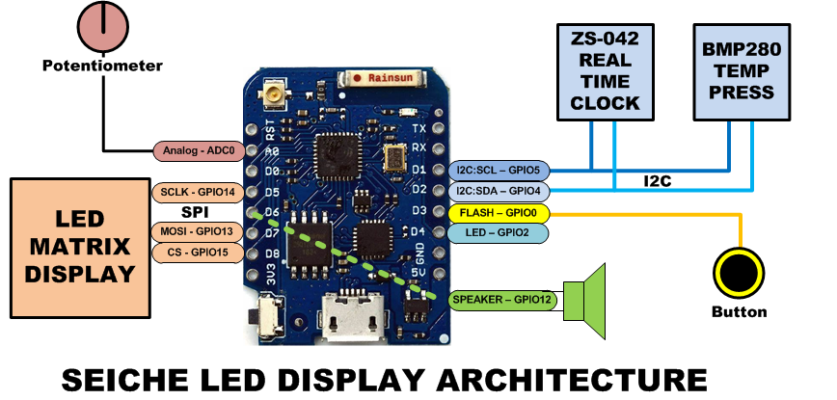
SEICHE LED Display Architecture
Red MAX7219 8x32 LED matrix display (SPI)
ZS-042 real-time clock module (I2C)
BMP280 Temperature and Pressure Sensor (I2C)
Piezoelectric speaker (PWM)
10KΩ Potentiometer (Analog-to-Digital Converter)
Button (Pullup and interrupt)

Slide 22
sprintf() Function Syntax
sprintf()’s formal syntax is: sprintf(char *buffer, const char *format, variable list)
buffer is an array of type char (the parameter when passed can also be a pointer [address] for such an array) which will contain the formatted output of the function
format is an unmodifiable (constant) array of char containing the format descriptors for all variables subsequently passed to the function, which is to say, it’s the format string.
The variable list are just the comma separated variables that are to be formatted
All variables passed in a single call to sprintf() are combined into a single output string
sprintf() automagically puts a terminating NULL (\0) at the end of the ASCII output

Slide 23
sprintf() Format Strings
sprintf() format strings contain conversion specifiers that specify how each individual variable is to be converted
sprintf() conversion specifiers have the following general syntax (all begin with a percent-sign):
%[flags][minimum field width][.][precision][length][conversion character]
% - special token that indicates the start of a conversion specifier
Flags – these modify the behavior of the specification
Minumum field width – as it says on the tin; this the minimum number of characters to be converted
. – The period is a separator between field width and precision
Precision – means one of the following depending on the variable type and conversion specifier
The maximum number of characters to be generated from a string
The number of digits after the decimal point for type float conversions (e, E, or f)
The zero-filled minimum number of digits for an integer
Conversion character – A single character which determines the output type of the conversion specifier; a single character that specifies the type of output format for the corresponding data or variable

Slide 24
sprintf() Conversion Specifiers
Below are the general conversion specifiers and what they do.
Specifier | What it does
d, i | int - integer; signed decimal notation
o | int – unsigned octal (no leading zero)
x, X | int – unsigned hexadecimal, no leading 0x
u | int – unsigned decimal
c | int – single character, after conversion to unsigned char
s | char * - characters from string are printed until \0 (NULL) or precision is reached
f | double – decimal notation of form [-]mmm.ddd where number of decimals is specified by precision; precision of zero (0) suppresses the decimals altogether
e, E | double - exp notation; default precision of 6, 0 suppresses
g, G | double – Use %f for <10^4 or %e for >10^4
p | void * - print output as a pointer, platform dependent
n | Number of characters generated so far; goes into output
% | No conversion, put a % percent sign in the output

Slide 25
sprintf() Conversion Specifiers
Below are the flags and what they do.
Flag | What it does
- | Left justification
+ | Always print number with a sign
spc (space) | Prefix a space if first character is not a sign
0 (zero) | Zero fill left for numeric conversions
# | Alternate output form depending on conversion character o – first digit will be zero x or X – 0x or 0X (respectively) prefixed to non-zero results e, E, f, g and G – Output will always have a decimal point g and G – trailing zeroes will never be removed

